Slide 1
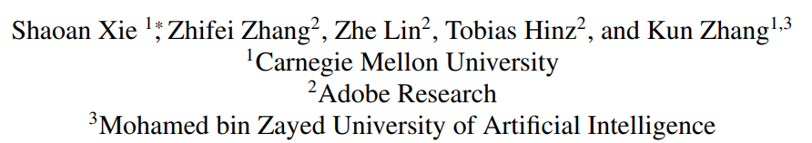
SmartBrush: Text and Shape Guided Object Inpainting with Diffusion Model
CVPR, 2023, 83 citation

Slide 2
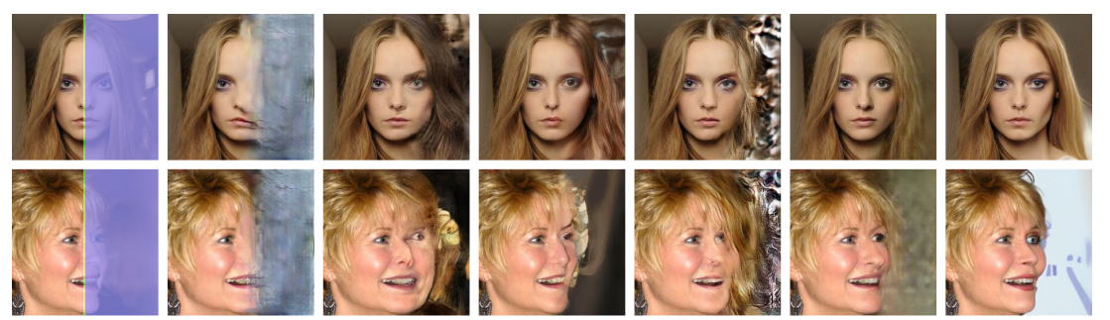
Image Inpainting
Traditional image inpainting
Fill in the masked region of the image
No guidance

Slide 3
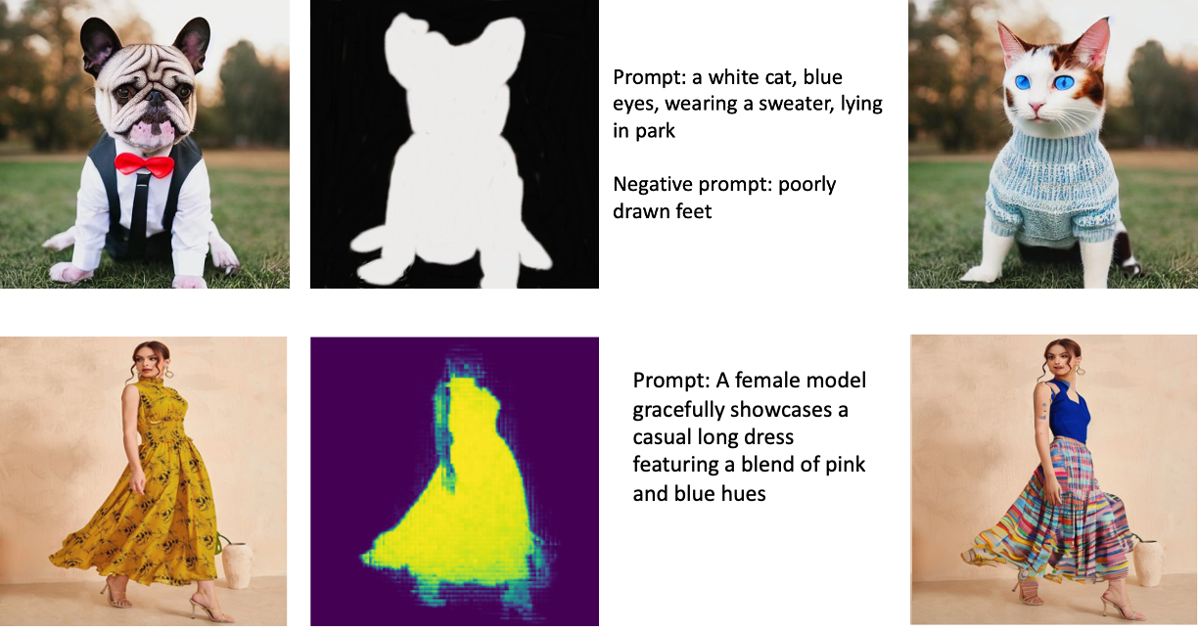
Image Inpainting
Multi-Modal image inpainting
Fill in the masked region of the image using guidance (e.g., text, segmentation map)

Slide 4

Image Inpainting
Image inpainting with text-to-image model
Fill in the masked region of the image using text guidance
Given image, text prompt, and binary mask, background of generated image should be the same as the background of original image and masked region should be aligned with prompt and mask

Slide 5
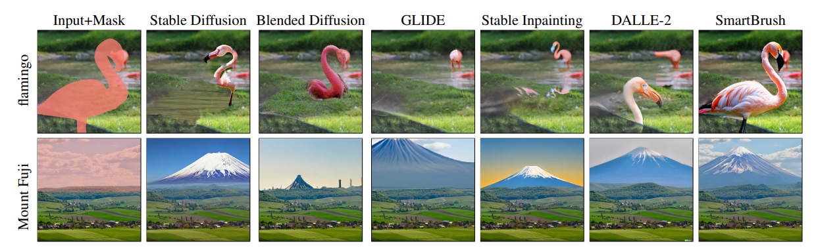
Image Inpainting
Problem
Traditional: no guidance
Text-to-image diffusion model: don’t fully accept text condition

Slide 6
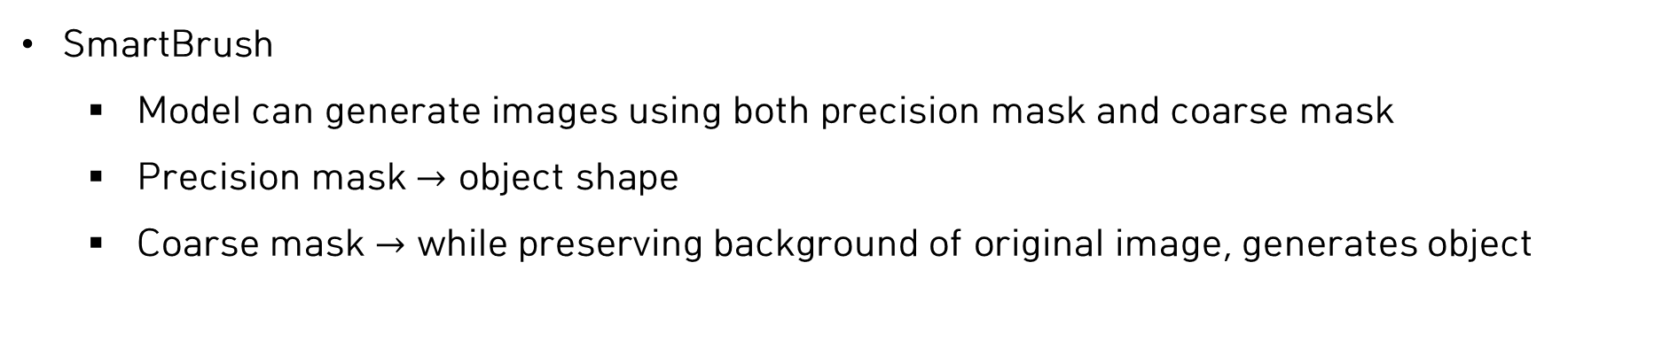
Image Inpainting
SmartBrush
Model can generate images using both precision mask and coarse mask
Precision mask $→$ object shape
Coarse mask $→$ while preserving background of original image, generates object

Slide 7
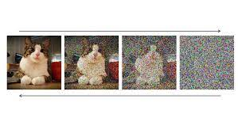
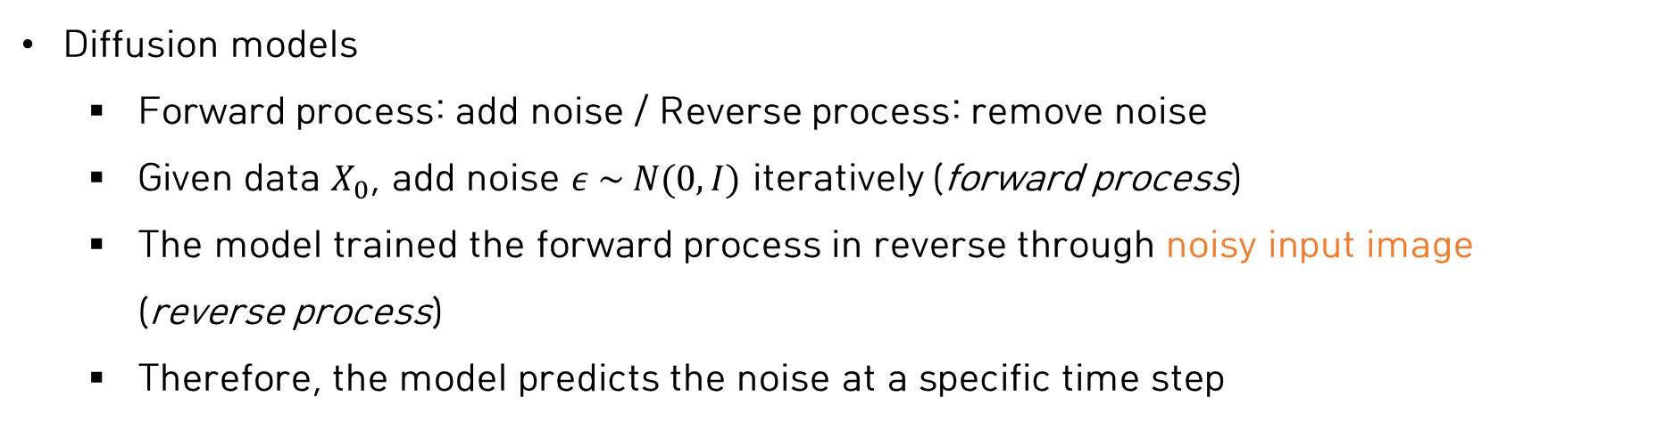
Background
Diffusion models
Forward process: add noise / Reverse process: remove noise
Given data $X_{0}$, add noise $ε \sim N(0,I)$ iteratively (forward process)
The model trained the forward process in reverse through noisy input image (reverse process)
Therefore, the model predicts the noise at a specific time step
$$x_{t}=\sqrt{\overline{α_{t}}}x_{0}+\sqrt{\left(1−\overline{α_{t}}\right)}ε$$
Forward process (add noise)
Reverse process (remove noise)

Slide 8
Method
Problem
Text-to-image diffusion model: don’t fully accept text condition
Existing methods erase randomly a part of entire image

Slide 9
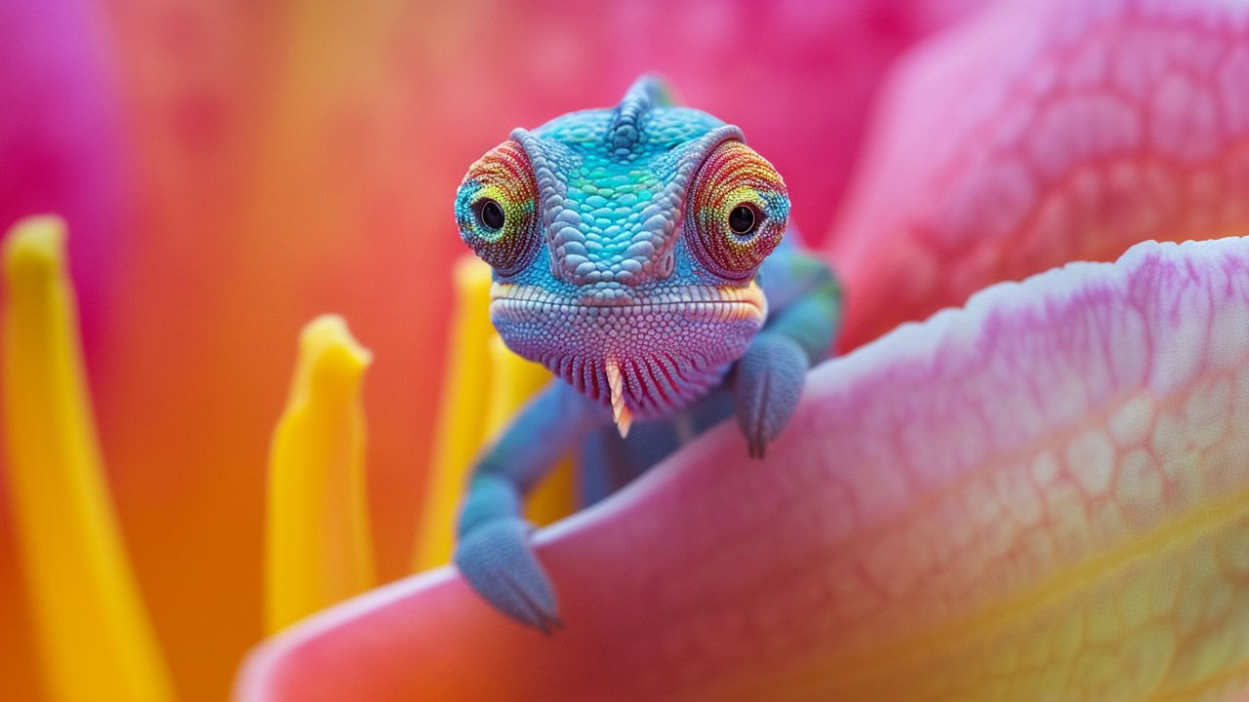
Method
Problem
Text-to-image diffusion model: don’t fully accept text condition
Existing methods erase randomly a part of entire image
May not reflect all text information within the mask region

Slide 10
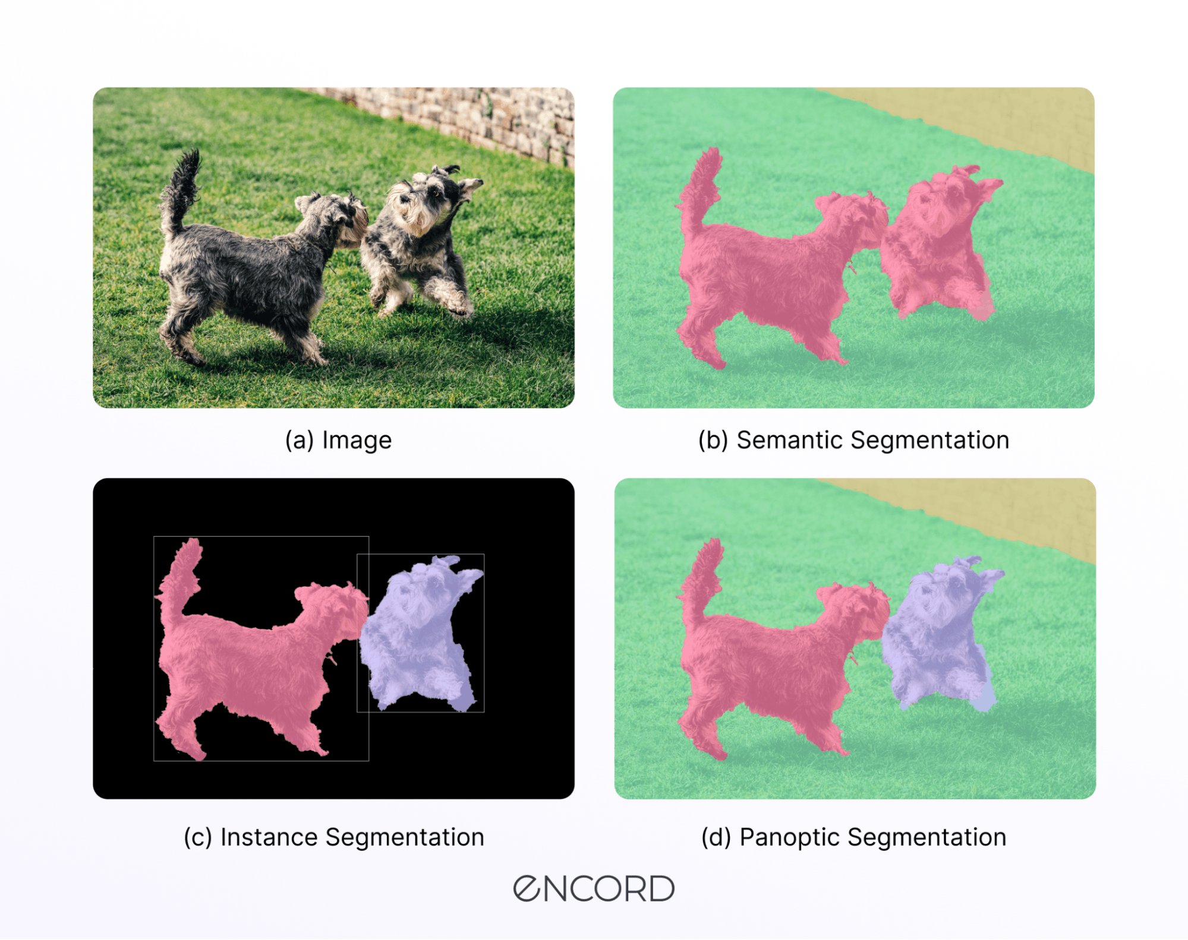
Method
Text and shape guided diffusion
Use existing instance/panoptic segmentation dataset with class label (text)
Mask region only contains object

Slide 11
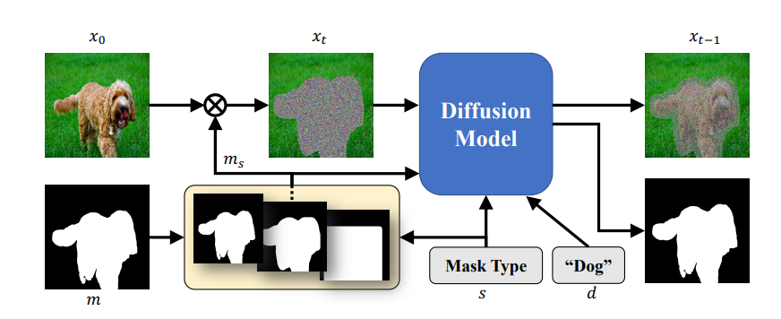
Method
Text and shape guided diffusion
Use existing instance/panoptic segmentation dataset with class label (text)
Mask region only contains object
Model generates objects that accurately follow the shape of the input mask
?
?
?

Slide 12
Method
Coarse mask: while preserving background of original image, generates objects

Slide 13
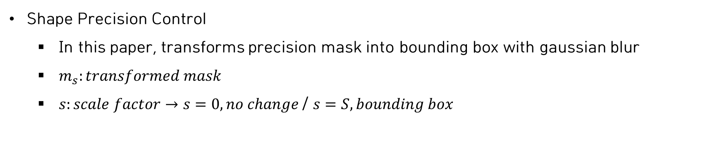
Method
Shape Precision Control
In this paper, transforms precision mask into bounding box with gaussian blur
$m_{s}:transformed mask$
$s:scale factor→s=0, no change$/ $s=S, bounding box$
?
?

Slide 14
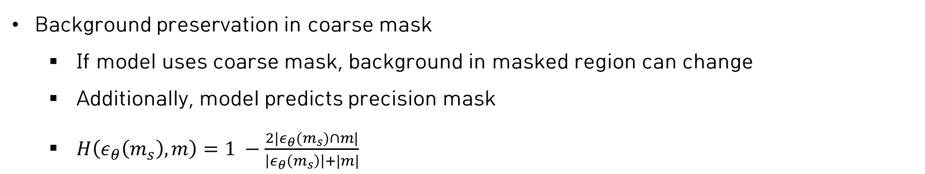
Method
Background preservation in coarse mask
If model uses coarse mask, background in masked region can change
Additionally, model predicts precision mask
$H\left(ε_{θ}\left(m_{s}\right), m\right)=1 −\frac{2|ε_{θ}(m_{s})∩m|}{\left|ε_{θ}\left(m_{s}\right)\right|+|m|}$

Slide 15
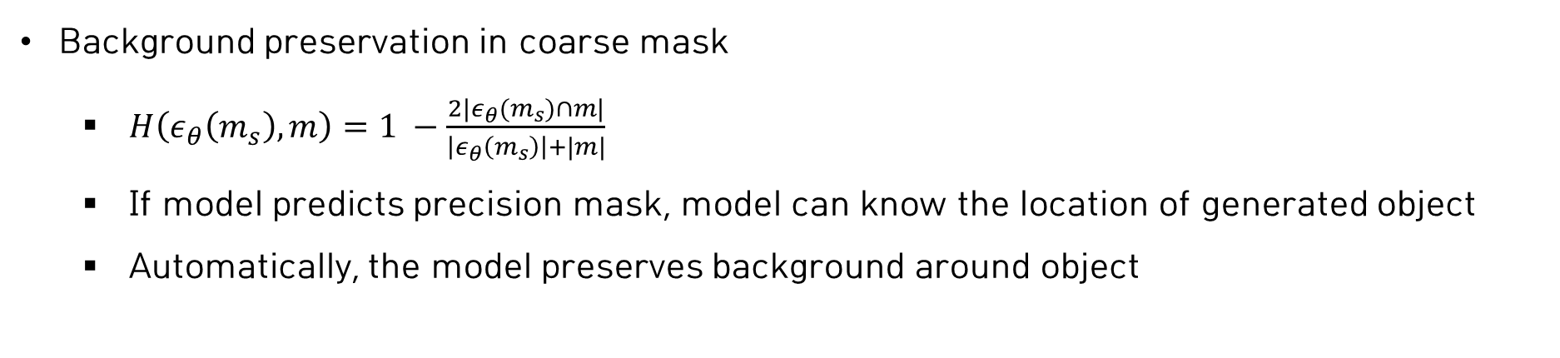
Method
Background preservation in coarse mask
$H\left(ε_{θ}\left(m_{s}\right), m\right)=1 −\frac{2|ε_{θ}(m_{s})∩m|}{\left|ε_{θ}\left(m_{s}\right)\right|+|m|}$
If model predicts precision mask, model can know the location of generated object
Automatically, the model preserves background around object

Slide 16
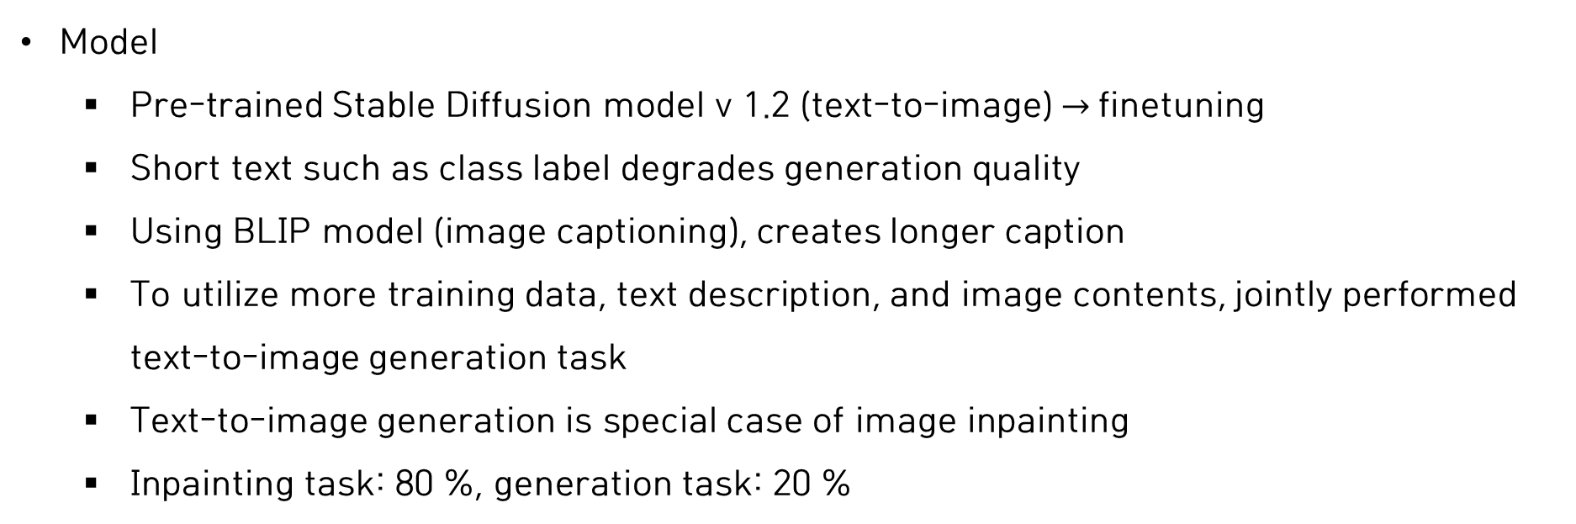
Experiment
Model
Pre-trained Stable Diffusion model v 1.2 (text-to-image) $→$finetuning
Short text such as class label degrades generation quality
Using BLIP model (image captioning), creates longer caption
To utilize more training data, text description, and image contents, jointly performed text-to-image generation task
Text-to-image generation is special case of image inpainting
Inpainting task: 80 %, generation task: 20 %

Slide 17
Experiment
Baseline model (diffusion model)
Blended Diffusion, Stable Diffusion, GLIDE, Stable Inpainting, DALLE-2
Evaluation metrics
FID, local FID with image crop

Slide 18
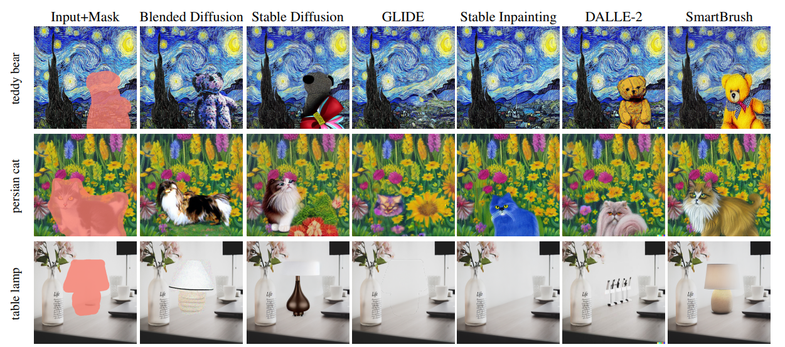
Experiment: Precision mask

Slide 19
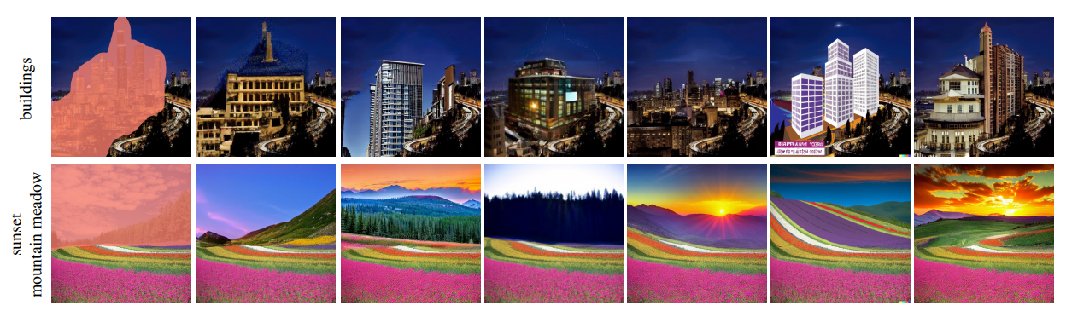
Experiment: Coarse mask

Slide 20
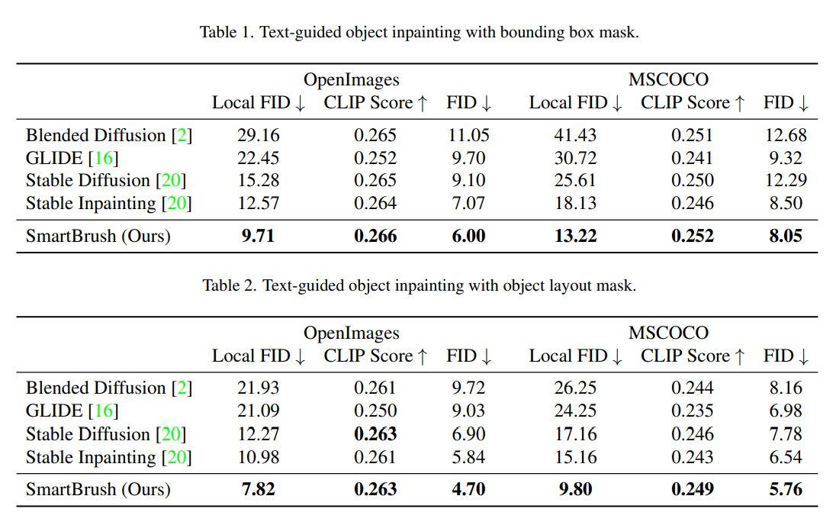
Experiment

Slide 21
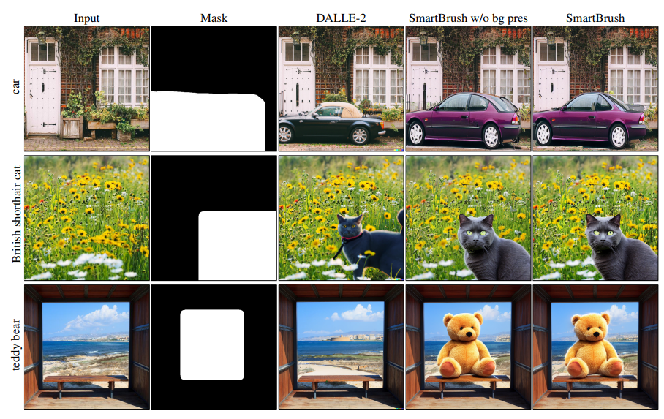
Experiment: background perservation

Slide 22
Experiment: background perservation

Slide 23
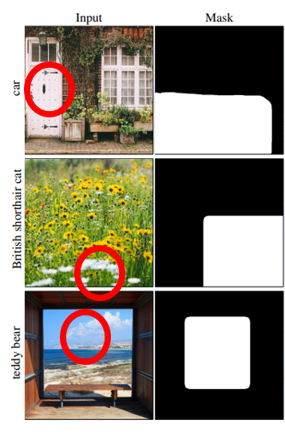
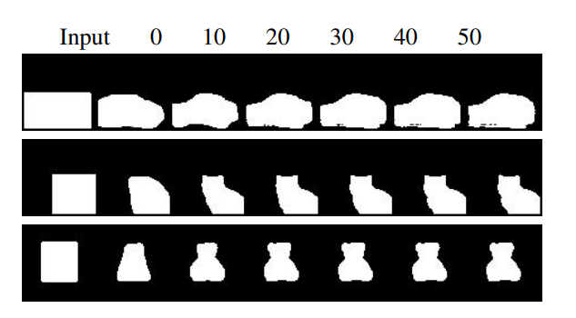
Experiment: Mask prediction

